Slide 1
Introduction to Nessus and Vulnerability Scanning

Slide 2
What’s is a Vulnerability ?
Definition:
A weakness that can lead to a compromise
Type of Vulnerabilities:
(Mis)Configuration – caused by vendors or user implementing improper setting.
Implementation – errors in coding techniques – SQL injections
Design – inherent in the protocol, application or architecture

Slide 3
Where do we find Vulnerabilities ?
Hosts – operating systems and services
Devices – routers, switches
Applications – client server, web applications, databases

Slide 4
Vulnerability Scanner
Nessus an easy to use yet powerful vulnerability scanner that can be used at home as well as major corporation.
Use the home version and practice to get familiar with its interface and now to configure vulnerability scanners.

Slide 5
Cautions
Be very careful
YOU CAN VERY EASILY LAUNCH A DENIAL OF SERVICE ATTACK WITHOUT KNOWING IT.
Rules of engagement. What you can do and can;t
Nessus can bring down a critical service and/or servers.
Always notify your system administrator that you are running a vulnerability scan and to have there systems.

Slide 6
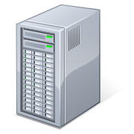
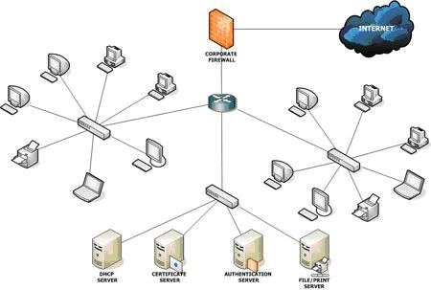

Client Server
Client – User Interface Server Target Network Scan

Slide 7
Nessus – Work Flow
Determine which ports are open,
Determine, for each port which service is running. Application and version.
Lookup the in the vulnerability database to find vulnerabilities for those applications found.
Send probes to the remote service to verify that vulnerabilities actually exists.

Slide 8
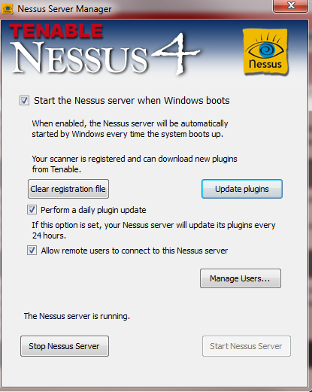
Server

Slide 9
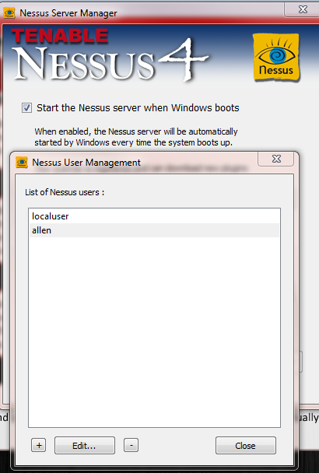
Configuration – Initial Configuration
Update Plugins
Double click and update user plugins
Manage Users
Double click

Slide 10
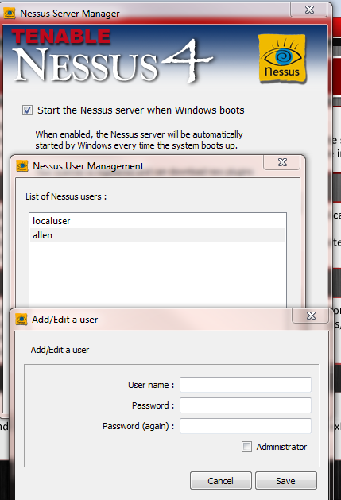
Add User

Slide 11
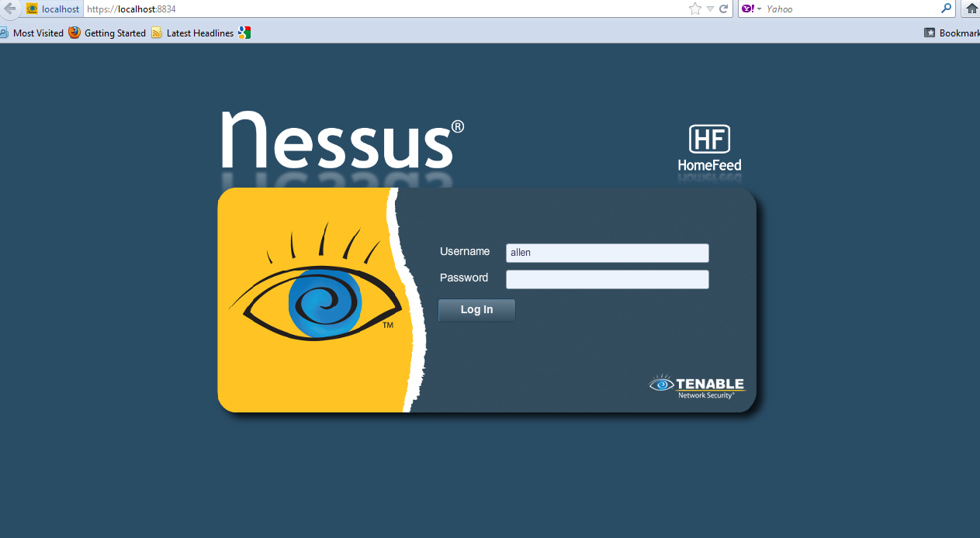
Sign In
Open up your Browser and
https://localhost:8834

Slide 12
Scanning Policies
What to Scan on your target
Policies define how to scan your traget
Global Scan Setting
What to check for and report on
Credentials and other applications specific setting
You may define different policies for different purposes

Slide 13
Creating Policy
Before you can execute a Nessus Scan a Policy must created.
A policy contains scan details
Policies are constructed in 4 parts
General
Name
Port Scan
Scan Intensity
Scan Options
Credentials
Plugins
Family
Individual
Preferences

Slide 14
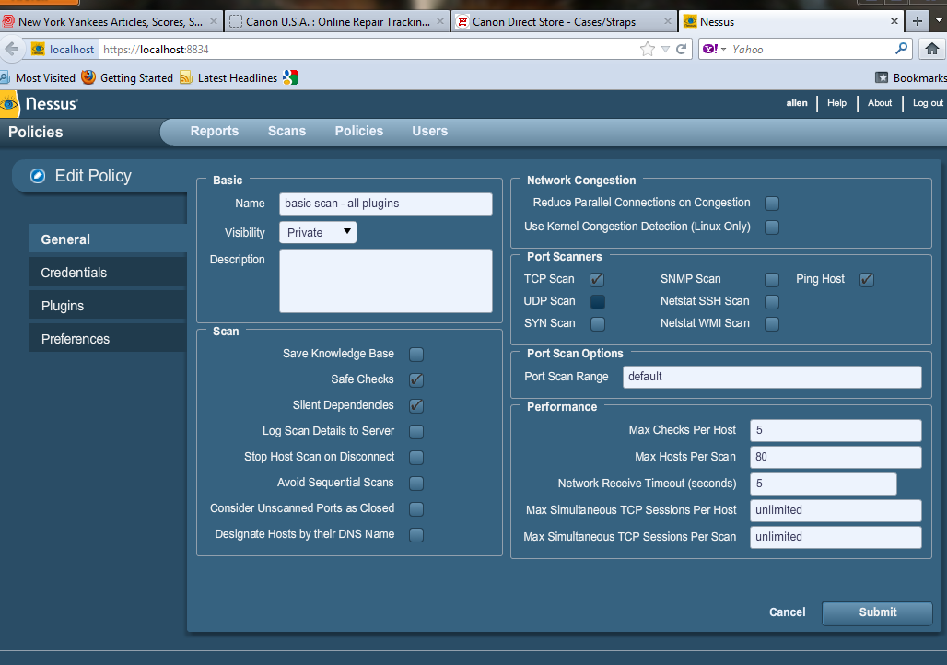
Configure Scan Policy

Slide 19
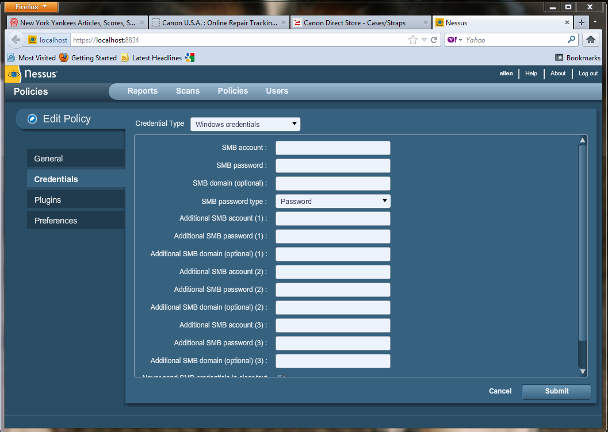
Configure Scan Policy

Slide 20
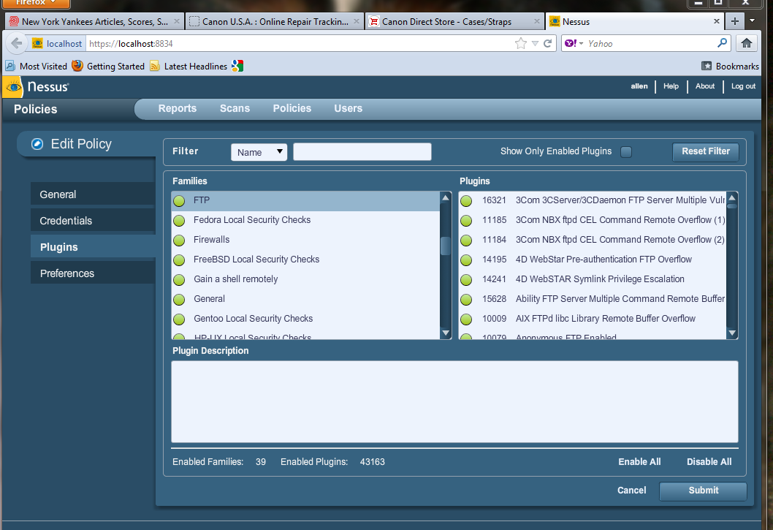
Configure Scan Policy

Slide 21
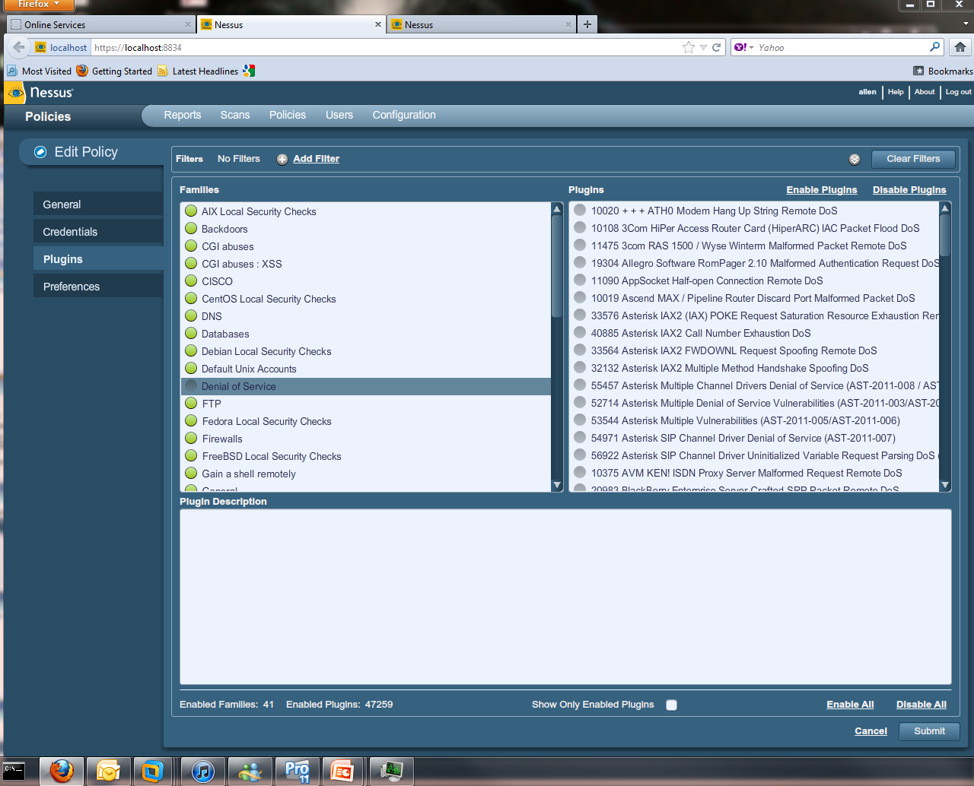
Configure Scan Policy

Slide 22
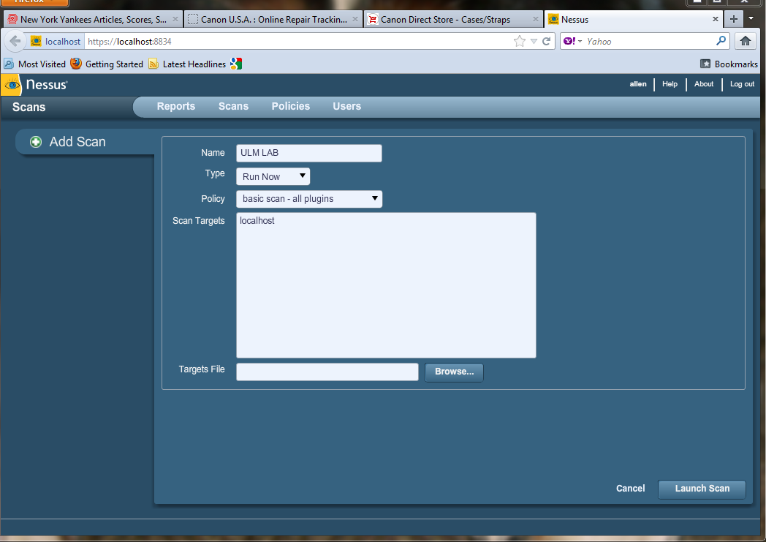
Execute Scan
Select a Scan Policy.
Enter your target hosts.
Ensure that the client or auditee is notified of the scan.
Recheck your target Host.
Submit the Scan for Processing.

Slide 23
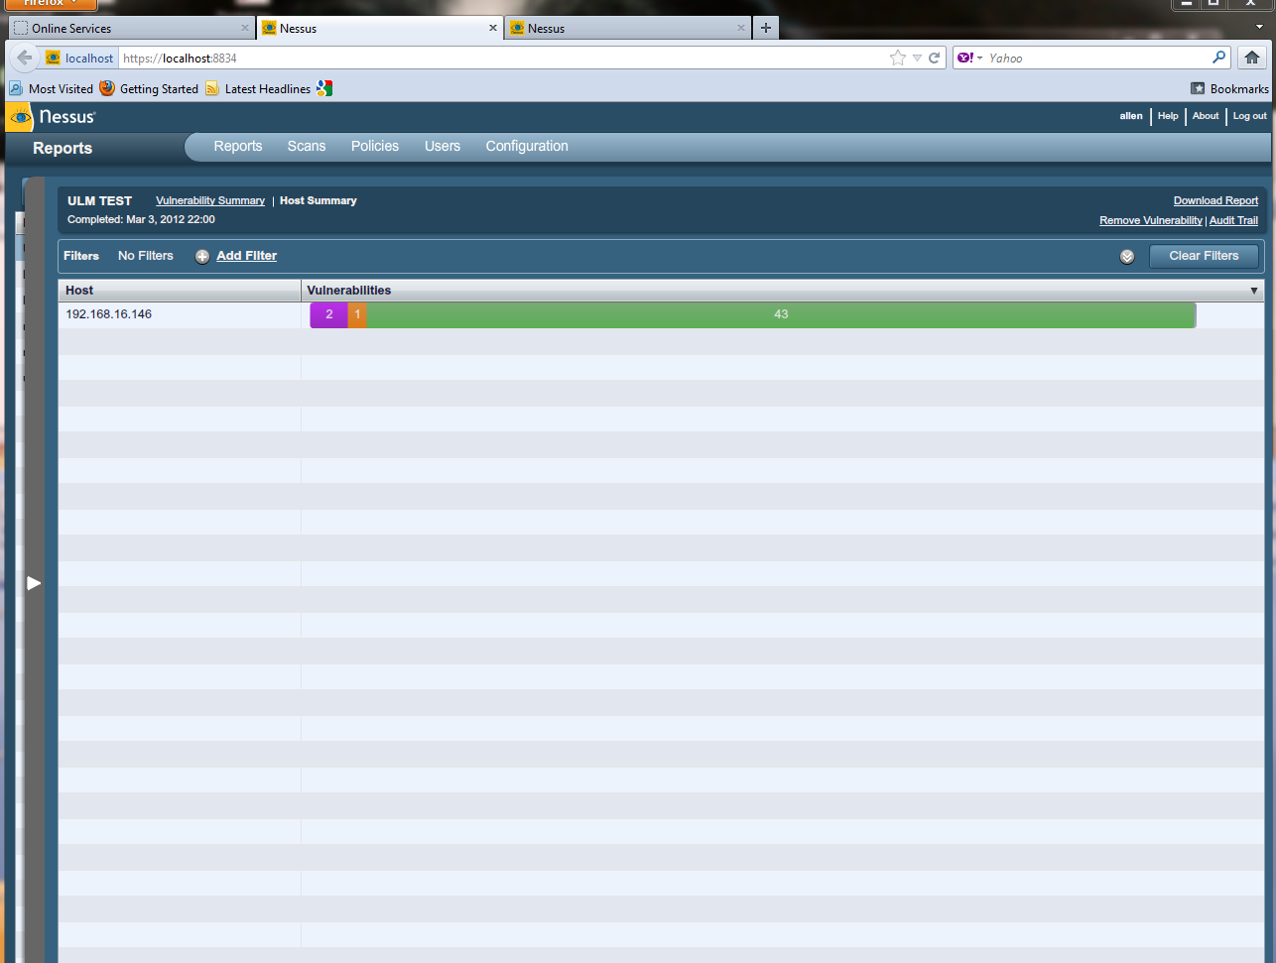
Scan Status

Slide 24
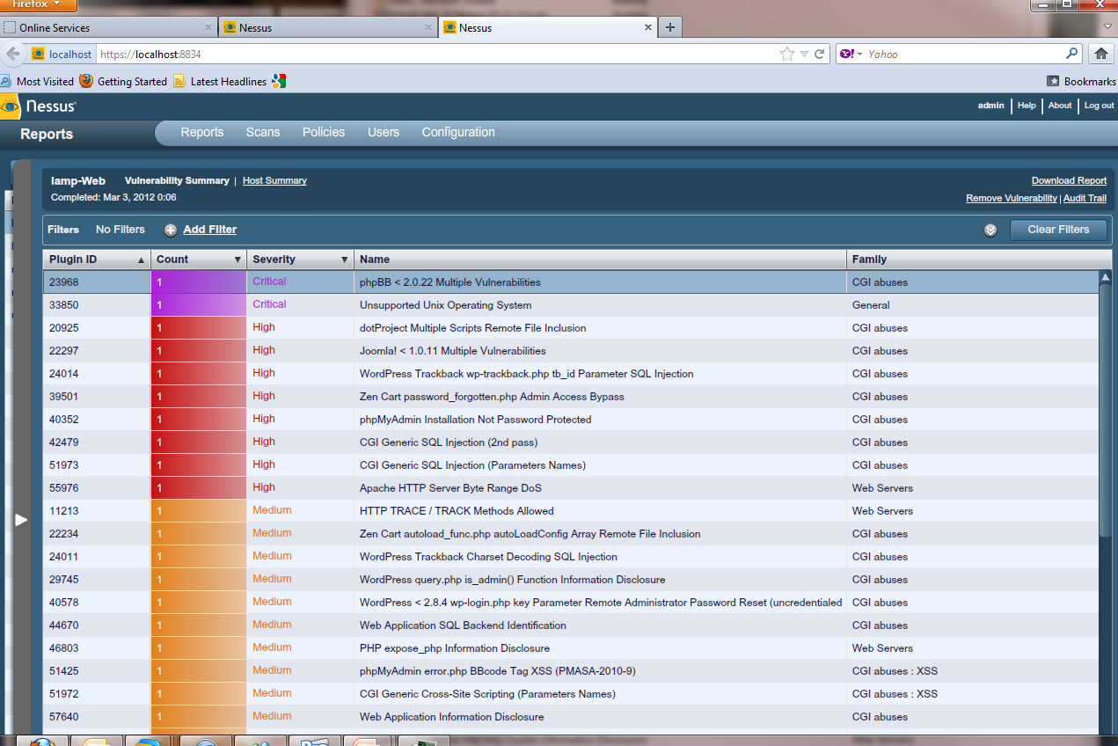
Results

Slide 25
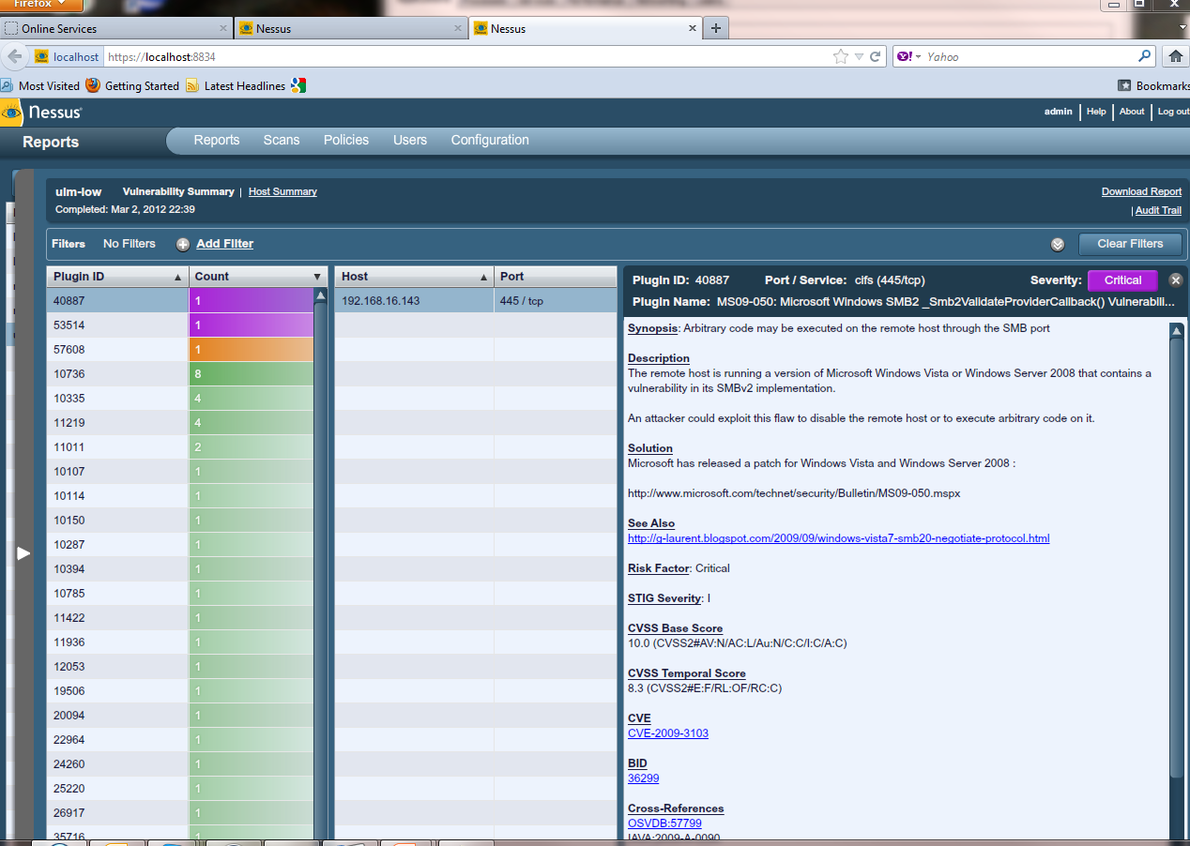
Nessus Report

Slide 26
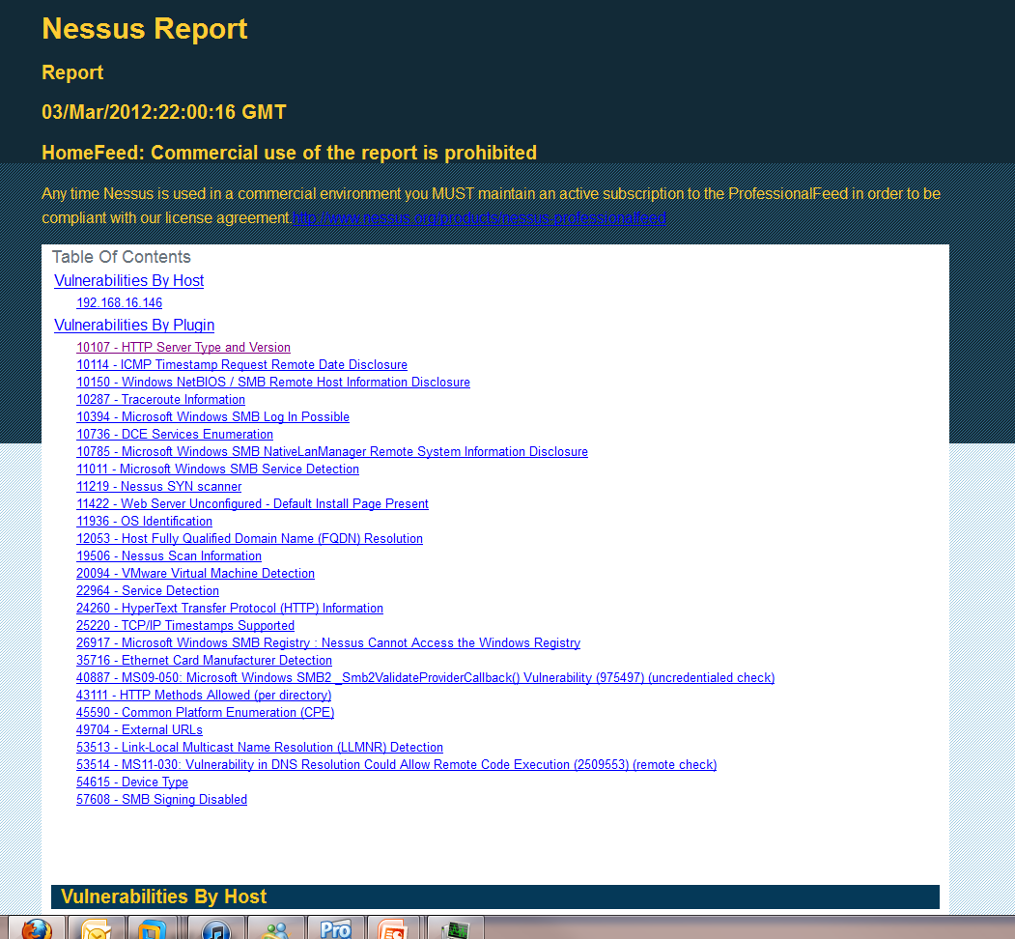

Slide 27

Nessus Results
Nessus Ranks the Scans Finding– High Medium and Low
Always Pay Attention to the High Finding
False Positives
Always confirm your finding with the Systems Administrators
Many Finding can be fixed by configurations changes and updating patches.

Slide 28
Recap
Nessus is a vulnerability Scanner
Review your rules of engagement !!!
Cautions on the Configurations – do not USE DENIAL of Service ATTACKS.
Be aware of your targets.
Ensure that the client or auditee knows of your scan.
Confirm the vulnerabilities before presenting to client.

Slide 29
LAB

